Slide 1
Enhanced Memory Diagnostic with Machine Check Architecture Support
Maggie Tong
JDS-SW
2011-05-09

Slide 2

Agenda
Machine Check Evolution
MCA (Machine Check Architecture) Introduction
Memory Diagnostic Principle
Data processing
Memory Diagnostic Software Architecture
Memory Software Flow

Slide 3
Machine Check Evolution
System halt
Restart when hardware error occurs
MCE ( Machine Check Exception)
a type of hardware error that occurs when CPU detects a hardware problem, internal error detection, including MCAR, MCTR, (Machine Check Exception)#MC, MCE flag of CR4, APCHK#, PCHK#, IERR#, BUSCHK# signals.
Windows displays the error using the Blue Screen of Death
Linux displays Kernel Panic
Interrupt 18, abort class exception
Disadvantage
Errors non-graded
Error messages are very limited and rely on BIOS
Restart system
MCA (Machine Check Architecture)
a mechanism in which the CPU reports hardware errors to the operating system, such as PCI BUS, CHIPSET, Memory, CACHE, TLB and so on.
IDF2011：英特尔至强E7详细RAS特性披露
RAS Clusters and
Cloud-computing Center
Reliability, Availability and Serviceability
CPU/Memory Hotplug, downtime is less,
System log, dynamic detection

Slide 4

X86 Machine Check Architecture
Machine Check Architecture
MCA refers to a mechanism in which the CPU reports hardware errors to the operating system.
Intel Xeon, P6 family as well as Itanium architecture implement a machine check architecture that provides a mechanism for detecting and reporting hardware(machine) errors, such as: system bus errors, ECC errors, parity errors, cache errors, and translation lookaside buffer errors. It consists o a set of model-specific registers (MSRs) that are used to set up machine checking and additional banks of MSRs used for recording errors that are detected.
MCA subsystem covers 5 major subsystems which the processor.
External Bus Logic
Back-side Bus Logic
Data Cache Unit
Data Translation Look-aside Buffer
Instruction Fetch Unit
A key feature of MCA is its ability to detect and correct errors by allowing the process to be recognized by OS software and other important elements to the server system. MCA is capable of analyzing data and responding to it in a way that enables higher overall system reliability and availability.

Slide 5
Machine Check Architecture Hardware
MCA errors category table
Error Handling | Category
System Reset Multi-bit Error in Kernel | Non-Recoverable/Fatal
OS Recoverable: System Available Multi-bit Error in Application | Uncorrected Recoverable
OS Corrected: Execution Continues Patrol Scrub Error | Recoverable
Firmware Corrected: Execution Continues Single-bit Error in Write-Through Cache | Corrected
Hardware Corrected: Execution Continues Most Single-bit Errors | Corrected

Slide 6
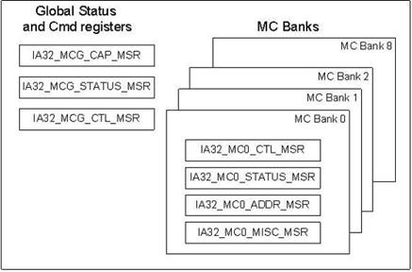
Machine Check Architecture Hardware (contd.)
MCA model specific registers (MSRs) sketch map
Error-Reporting Bank Registers
(One Set for Each Hardware Unit)
MCA consist of a set of global control and status registers and several error-reporting register banks. Each bank for one kind of errors such as CPU, MEMORY, CACHE, CHIPSET etc.

Slide 7
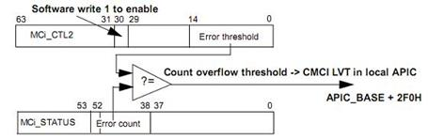
Machine Check Architecture Hardware (contd.)
Older system check in a regular timer
Newer systems have support CMCI (Corrected Machine Check error Interrupt) for fast notification
APEI (ACPI Platform Error Interface)
ACPI 4.0
A unified error communication interface between firmare/BIOS and OS
Error record serialization table (ERST), BOOT error table (BERT), Hardware error source table (HEST), Error injection table (EINJ)
Error injection

Slide 8

Machine Check Errors for Intel Xeon Processor 7100 series,7400 series
The processor’s L3 errors
Correctable/Uncorrectable error
Cache Bus Controller Errors
Intel Cache Safe Technology Queue Full Error
Correctable ECC/uncorrectable ECC on outgoing Core 0/1/2
BUS / Interconnect Errors Compound Errors
FSB Request Parity
FSB Hard Fail Response
FSB Response Parity
Memory Controller Errors
Corrected error count, DIMM ID, Channel ID, ECC Syndrome
IA32_MC0_STATUS for QPI Machine Check Errors
IA32_MC7_STATUS for Internal Machine Check
IA32_MC8_STATUS for memory Controller Error
MC6_STATUS for (Internal Error, L3 tag Error, Bus and Interconnect Error) 7400 series
MC4_STATUS for (Internal Error, L3 tag Error, Bus and Interconnect Error) 7100 series

Slide 9
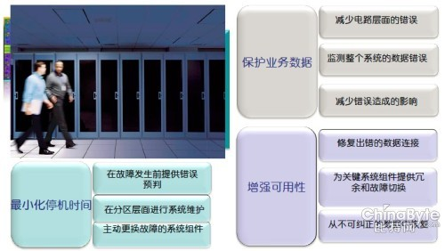
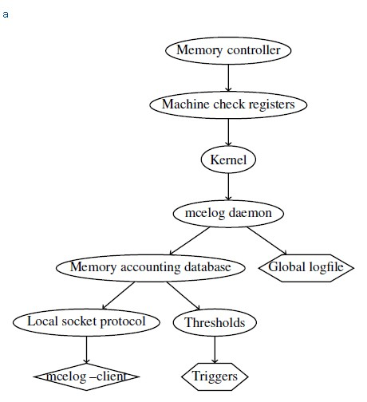
Machine Check Architecture Software
RAS

Slide 10
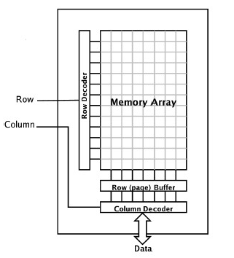
Memory Diagnostic Principle
Memory arrays
Write a cell with a zero
Write all of the adjacent cells with a one, one or more times
Check that the first cell still has a zero

Slide 11
Memory Algorithm Test
1. Address test, walking ones
2. Address test, own address
3. Random address test
4. Moving inversions, ones & zeros
5. Moving inversions, 8 bit pattern
6. Moving inversions, random pattern
7. Block move, 64 moves
8. Moving inversions, long pattern
9. Random number sequence
10. Modulo 20, ones & zeros

Slide 12
Enhanced Memory Diagnostic
Multi-threaded
Memory Diagnostic takes the advantage of multi-core CPUs by running the test with multiple threads.
Native 64-bit support
A native 64-bit support Memory Diagnostic is a good match with 64-bit processor.
Compatible with memtest86
Memory Diagnostic is compatible with memtest86. Most of Memory Diagnostic algorithms come from memtest86 algorithms plus a random address test which is a complement to memtest86 algorithms.
Full test-coverage
The test strategy is that Memory Diagnostic applies different approaches to different regions. All memory can be tested.
Physical address testing
All tests access memory by physical addresses.
ECC error reporting
Memory Diagnostic also reports the memory ECC counters after completing read-only test as well as algorithms R/W/C test. The ECC information provides users a reference about memory risk.
NUMA-aware
On NUMA platform machine, Memory Diagnostic test local memory with local CPUs given the related ACPI NUMA information.
Algorithm test/
Machine check
Read-only test/
Machine Check
Part I
Part II

Slide 13
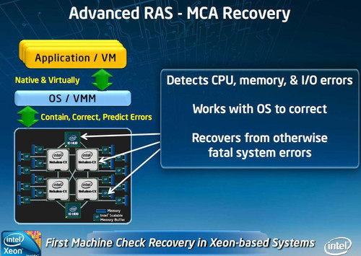
Enhanced Memory Diagnostic (contd.)
Algorithm test
Read
Write
Result

Slide 14
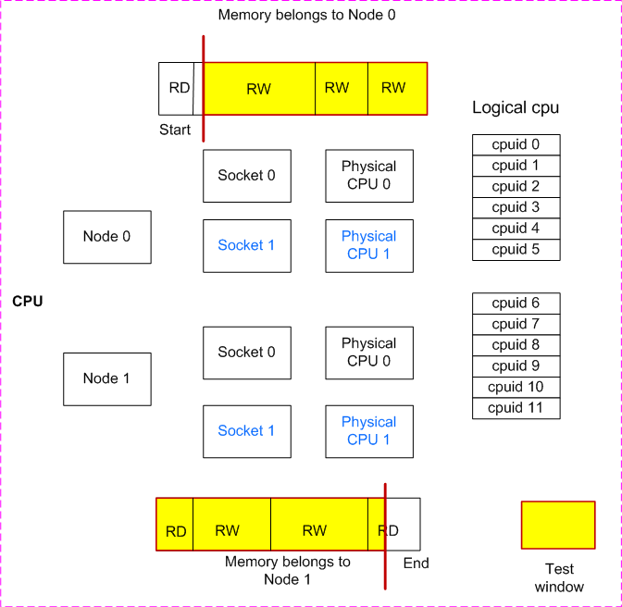
Data Processing Part
Logical relationship between CPU and Memory regions

Slide 15
Sliding Window Model
length
offset
start
end
One range
Test window
Another range
Test window
Offset + len < start
(offset <= start) && (start<=(offset+len)<=end)
(offset>start) && ((offset+len)<end)
(offset<start) &&((offset+len)>end)
(Start <=offset<=end) && ((offset+len)<=end)
Offset > end
skip
(start, offset+len)
(offset, offset+len)
(start, end)
(offset, end)
skip

Slide 16
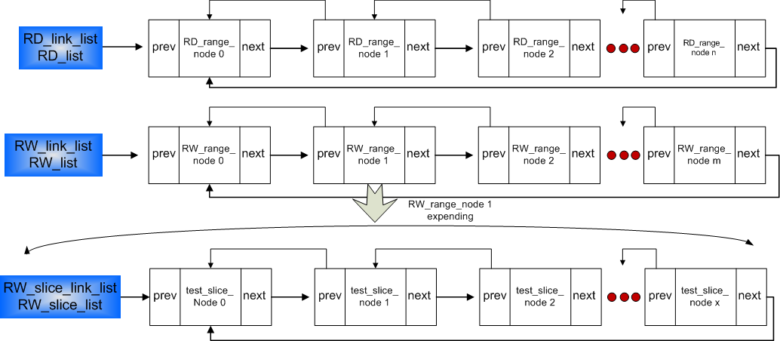
Key Data Structure
struct list_head { struct list_head *next, *prev; };
Transfer doubly linked lists into arrays

Slide 17
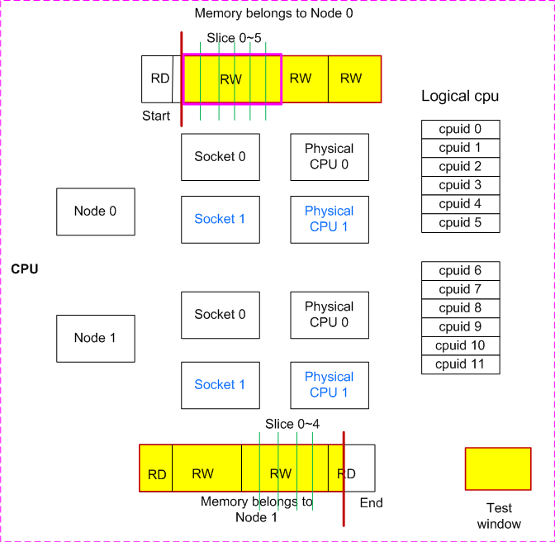
Test Policy

Slide 18
Test Policy (contd.)
Test mode definition
LOCAL is a strategy that using local CPU for performing local memory
REMOTE is a strategy that using local CPU for performing remote memory
ALL is a strategy that maximum utilize CPU performance
SPECIFIC is designed to specify one cpu-core to perform testing

Slide 19
Memory application interface
User
space
Application
layer
Test
main controller
Algorithm
test
Task
generator
Read-only test
MCE check
Linux system interface
Kernel
space
System
layer
Driver
memory mapping
Driver
mem
Driver
MCE
Linux kernel
Memory reservation
MCE Kernel Support
Hardware
layer
Hardware platform
Memory Diagnostic Software Architecture

Slide 20
Sub-
modules
Interaction

Slide 21
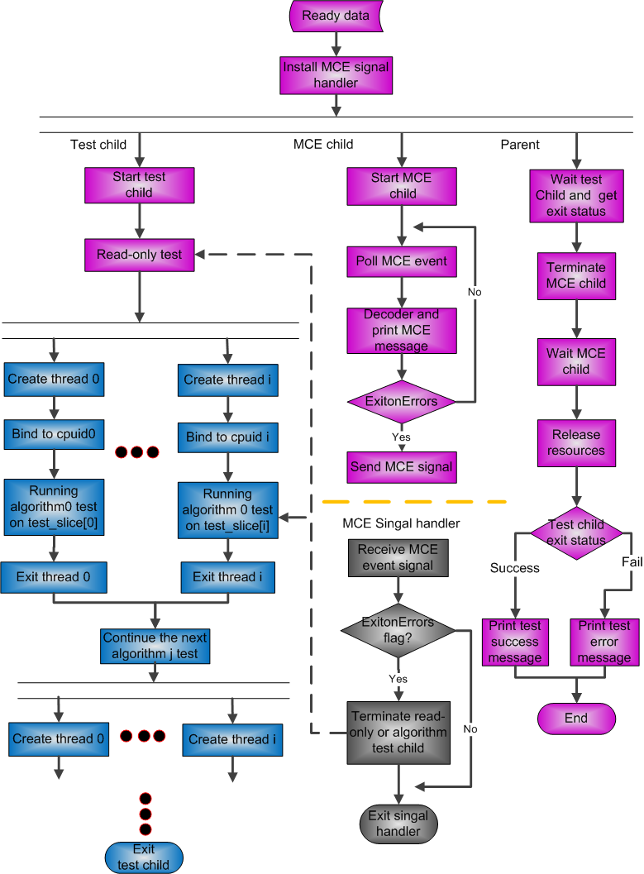
Main
Software
Flow

Slide 22
Test Memory Usage
testMemory [-t testitem] [-r start,end] [-p 2] [-m 1] [-d cpu*] [-c] [-E]
The common parameters usage
[-list] list the test item name and functions
[-v/V] show the utility version
[-h] print usage information
Parameters usage
[-d] cpu specify the cpu-core to perform testing,
for example, -d cpu0
[-t] testitem specify the test item, Specify several test items one time,
for example, –t 0, 6~2, 5, 8~9
[-r] start,end specify the testing range from the start address to the end address,
for example –r 0x1000,0x3FFFFFFFFF
[-p] verbose debug mode, for example –p 1
[-m] n mode specify the test mode, 0 for Default, 0 for LOCAL, 1 for REMOTE, 2 for SPECIFIC, for example –m 1
[-l] to show the information of memory algorithms testing and corresponding CPU/CPU core relations, read-only test regions
[-C] Clear Memory ECC
[-E] Exit when MCE error happens,
If no –e, continue test until finishing all test, even if MCE error happens
[-n] No comparison when performing algorithm test

Slide 23
References
《RAS 在 X86 上的应用及Linux 实现》
<Intel 64 and IA-32 Architectures Software Developer’s Manual>
<Memory Module Design Document>
<mcelog: memory error handling in user space>
<Memtest86 Technical Information>

Slide 24
Q&A
Thank You

